Slide 1
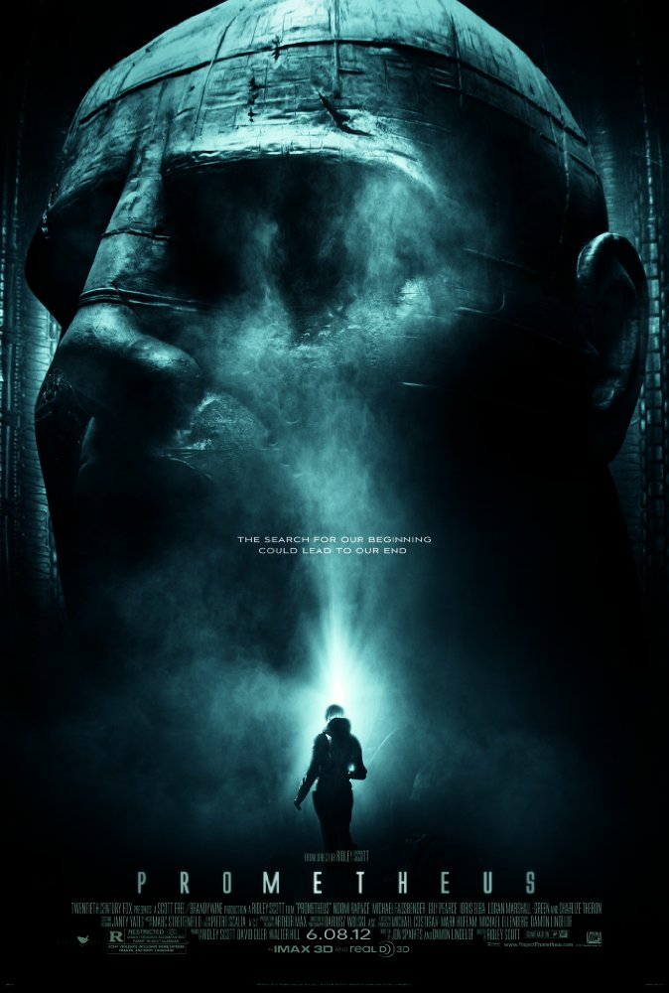
Synopsis
Prometheus
Have you ever wanted to travel to new and exciting places?
Have you ever wanted to “meet your maker”?
Have you ever wanted to kill your maker?
Image from http://www.imdb.com/title/tt1446714/
Notes:
Discover that “Engineers” or Aliens possibly existed and helped to create human society.
Get funding to travel to a moon that was hinted at in caves as to where their origin may be
When they reach the planet nothing goes right and the place is not what they are expecting
They are plagued by horrible events of their own making and horrible circumstances
Travel to new and exciting places
Meet new and interesting species
Get murdered by them

Slide 2

David
Prometheus
A sentient android helper
Experimental human emotions
Is David a moral agent?
Would him being sentient change the answer?
Image from http://www.australianscience.com.au/news/the-clues-to-human-uniqueness/
Notes:
As long as Weyland is alive, David is not a moral agent.
Since Weyland can define his orders, he does not have free will.
David says that when Weyland dies, he will be “free.”

Slide 3
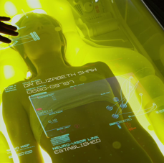
Privacy
Prometheus
David used dream eater
It was super concerning
“A decision Peter Weyland said he based on ‘a man should have the privacy, at least, of his own dreams.’ Yeah, very altruistic, and he wanted the technology all to himself.”
Image From http://www.alien-covenant.com/topic/45629
Notes:
David spied on people while they were sleeping
This would be a clear violation of everyone's privacy.
The cryo pods need to have the information so that people's vitals and mental health is all right
Violation of every moral no matter how you look at it
Super violation of the code of ethics.
2.05 - keep private any confidential information gained in their professional work…
3.12 - respect[s] the privacy of those who will be affected by the software.
Code of ethics should also apply to the software that you produce. By all of section 7
Quote from http://www.alien-covenant.com/topic/45629
David's decisions were his own

Slide 4

Work and Wealth
Prometheus
Automation
Android: long-term monitoring
Scanning robot: valuable new tool
Positive use of automation
<Graphic>
Image from http://alienanthology.wikia.com/wiki/Spectagraph
Notes:
Android used to conduct task to dangerous/monotonous tasks
Scanning robot conducts a task that could not realistically be done by humans
Technology enables new human actions that would not otherwise be possible, rather than replacing human workers
http://alienanthology.wikia.com/wiki/Spectagraph

Slide 5
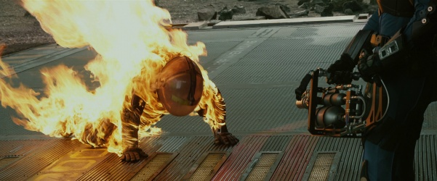
Work and Wealth
Prometheus
Corporate Space Travel
Relevant: SpaceX
Corporate abuse
Parallels with existing industries
↑
Unethical treatment of employees
Notes:
With recent trends towards corporate entities engaging in space travel, a scenario like that in the movie could develop where corporations can run missions with little government oversight.
There are real-world parallels to the kind of abusive/negligent corporate behavior when workers are isolated: mining towns in the 1800’s [citation needed], fishing vessels [https://www.nytimes.com/2015/07/19/world/stowaway-crime-scofflaw-ship.html]
Image: http://www.imfdb.org/images/thumb/3/30/Prometheus-flamegun3.jpg/601px-Prometheus-flamegun3.jpg

